Slide 1
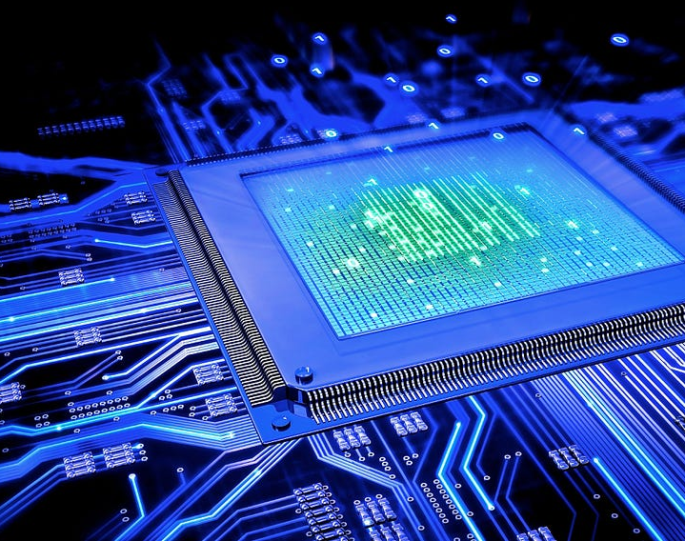
Computer system
Practice 1.
Yehor Burlachenko

Slide 2

Introduction. Memory system.
Today we are going to speak about different parts of memory.
What is computer memory? Computes memory is a device which stores data or programs. Memory can be temporary or permanent. Computer memory is divided into main memory and auxiliary memory. Main one hold instructions and data when a program is executing, while auxiliary memory holds data and programs not currently is use and provides long-term stotage.

Slide 3

Evolution in memory systems.
The memory system memory has undergone an incredible revolution. For example, we see how slow HDD disks became into fast and beautiful SSD.
1956: IBM introduced the first Hard Disk Drive (HDD), the IBM 305 RAMAC. It used magnetic disks to store data and had a storage capacity of 5MB, which was revolutionary at the time.
1970s: Early forms of Solid-State Drives (SSDs) began to appear, primarily for military and industrial applications. These early SSDs used semiconductor memory arrays, which were very expensive and had limited storage capacity.
1980s: SSD technology continued to develop, but high costs and limited capacity restricted their use to niche markets. Companies like StorageTek and Sharp developed SSDs for specific high-performance applications.
1991: SanDisk created a 20MB SSD for IBM, marking one of the first consumer-oriented SSDs. This was a significant step towards making SSD technology more accessible to the general public.

Slide 4

Evolution in memory systems.
2000s: Advancements in flash memory technology made SSDs more viable for consumer use. SSDs began to be used in laptops and other consumer electronics. Notable products included the Samsung SSDs and the introduction of the SATA interface, which improved compatibility and performance.
2008: Intel released its X25-M SSD, which significantly improved performance and reliability. This helped to popularize SSDs in the consumer market, offering faster read/write speeds and better durability compared to HDDs.
2010s: SSDs became more affordable and started to replace HDDs in many applications. The introduction of NVMe (Non-Volatile Memory Express) technology further enhanced SSD performance by reducing latency and increasing data transfer speeds. Companies like Samsung, Crucial, and Western Digital became major players in the SSD market.
2020s: SSDs have become the standard for high-performance storage in both consumer and enterprise markets. Capacities and speeds continue to increase, with SSDs now offering terabytes of storage and extremely fast data transfer rates. Innovations like 3D NAND technology and PCIe 4.0 interfaces have further pushed the boundaries of SSD performance.

Slide 5
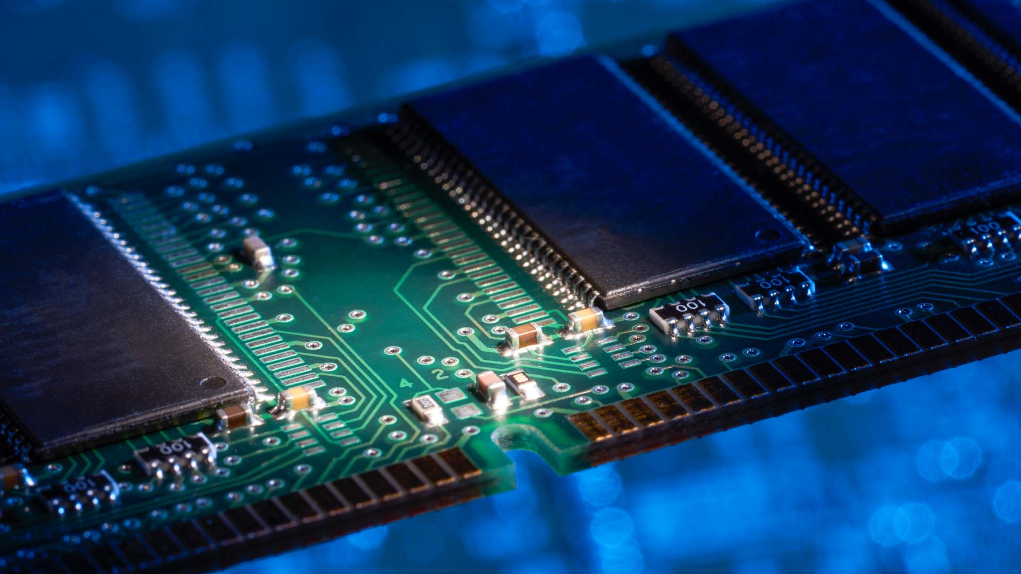
RAM memory. Types. Features. Prices.
RAM (Random-Access Memory) is a form of electronic computer memory that can be read and changes in any order, typically used to store working data and machine code. RAM has different forms, each with its own set features, speed, and cost. Now we are going to discuss all of them.

Slide 6
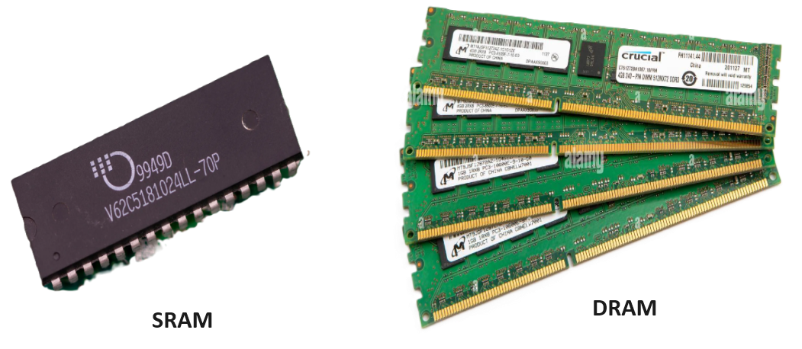
Static Random-Access Memory (SRAM) – is the fastest type of RAM available and is often used as cache memory for CPU. Price: 10-20$ per MB.
Dynamic Random-Access Memory (DRAM) - is the most commonly used type of RAM in personal computers. Unlike SRAM, DRAM is less expensive to produce but operates at a slightly slower speed. Price: 16 GB DDR4 module can cost between 50$ and 100$.

Slide 7
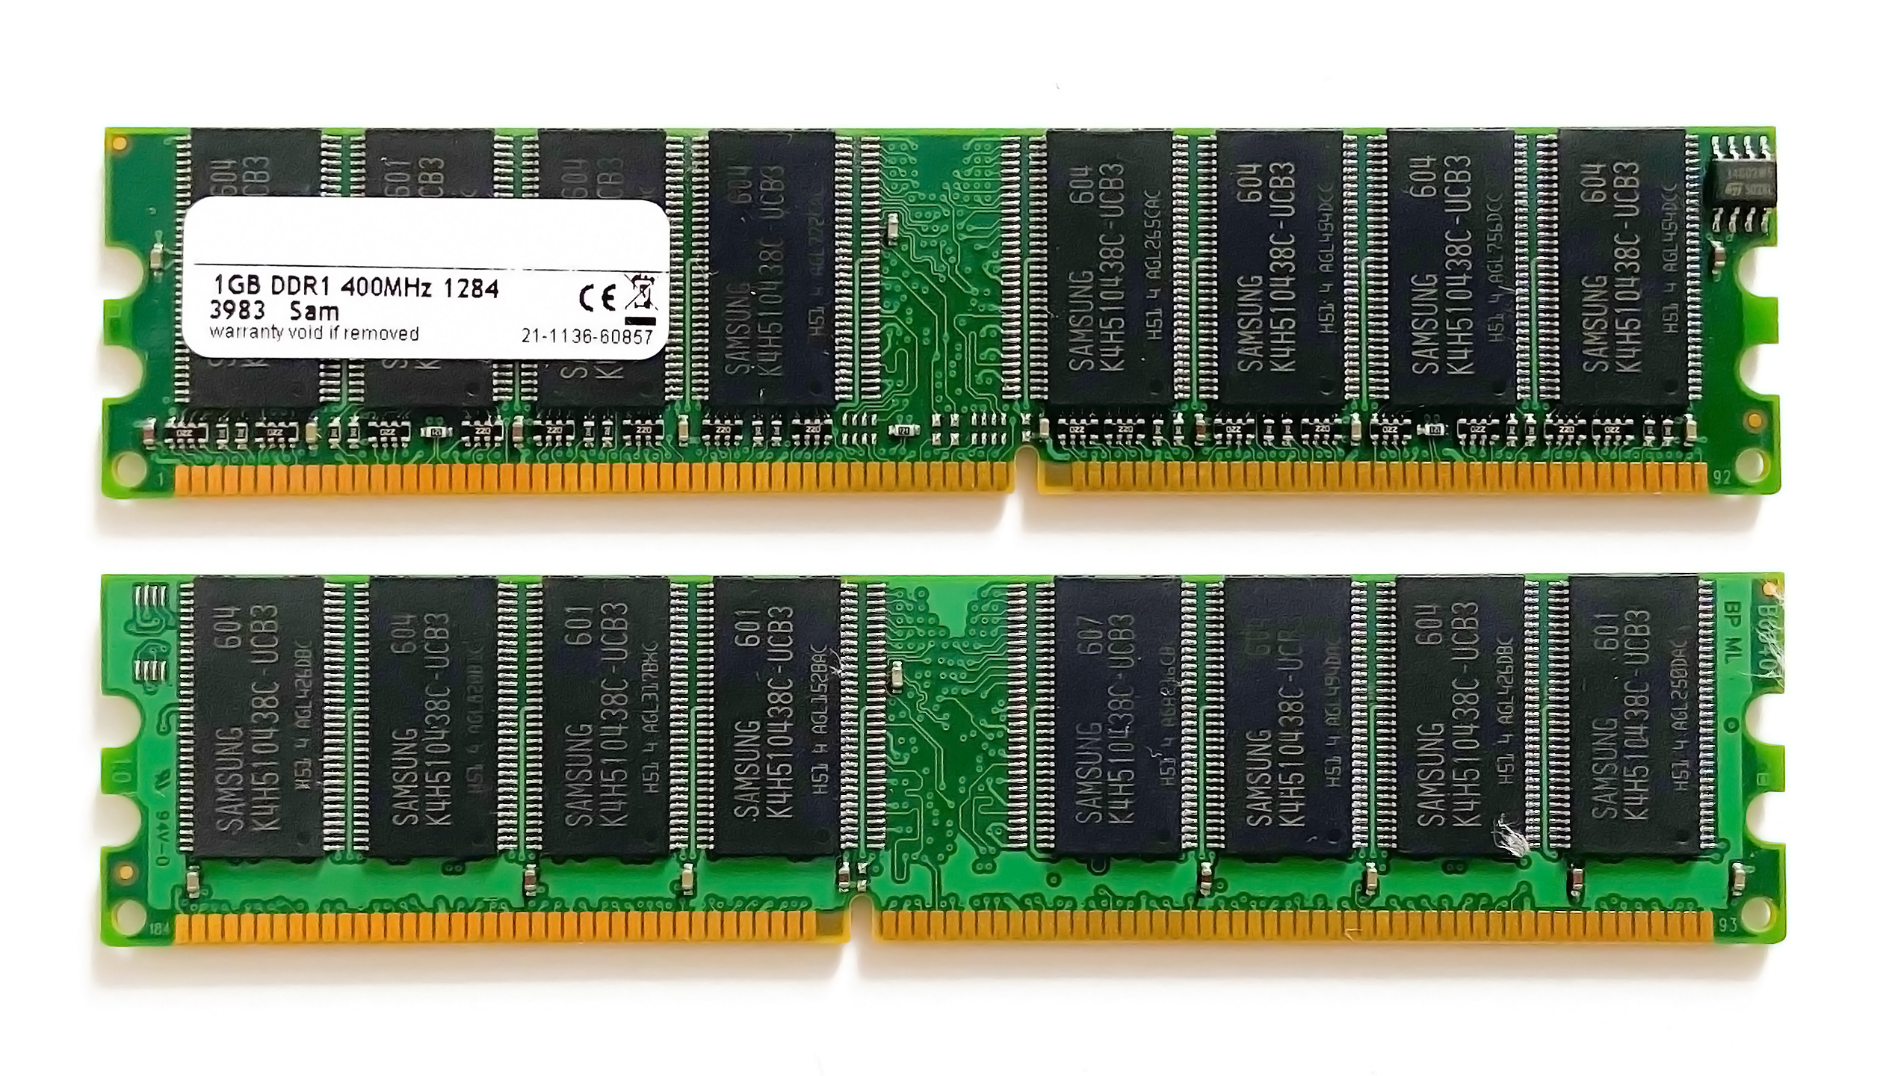
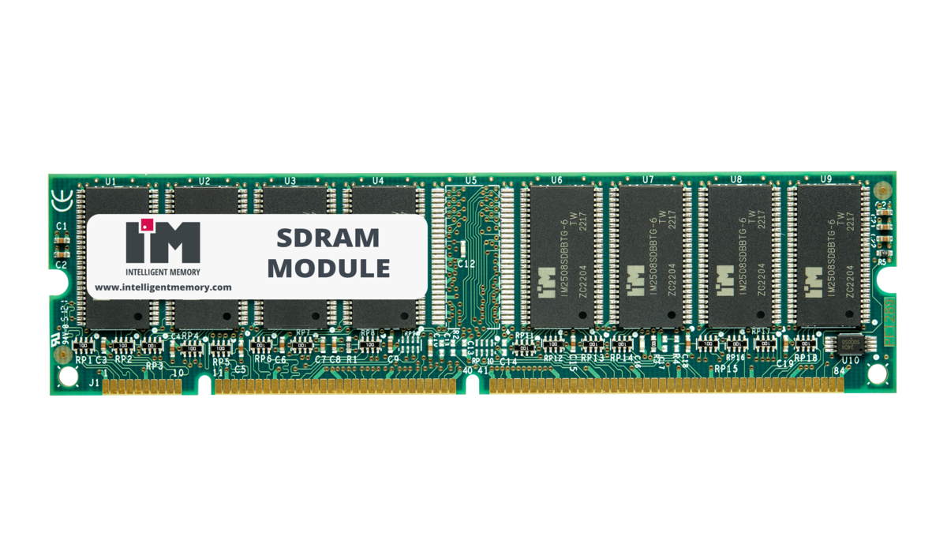
Synchronous Dynamic Random-Access Memory (SDRAM) - this RAM type is an advanced form of DRAM that synchronizes its operations with the clock speed of the CPU. This synchronization makes SDRAM more efficient and faster than traditional DRAM. Initially developed to meet the demands of increasingly faster computer components, SDRAM has become a standard for general-purpose computing. Price: 16 GB DDR4 module can cost between 50$ and 100$.
Double-Data-Rate Synchronous Dynamic Random-Access Memory (DDR SDRAM) - is an evolution of SDRAM technology that offers higher speeds by transferring data on both the rising and falling edges of the clock signal. This dual action effectively doubles the data transfer rate.

Slide 8
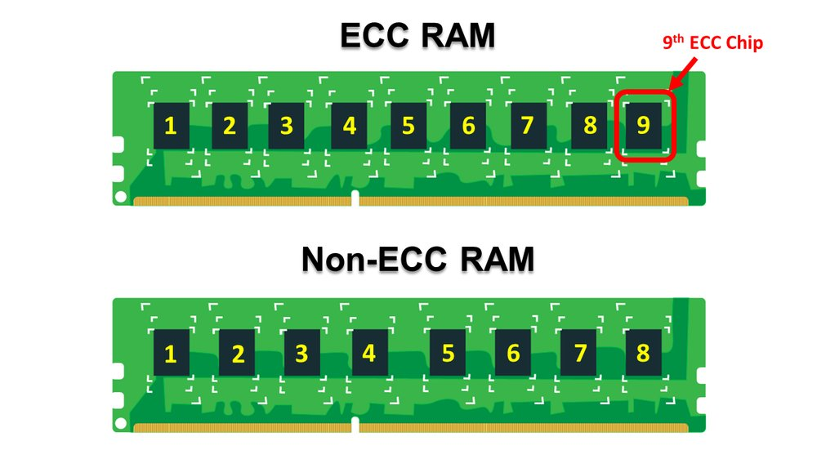
Error-Correcting Code Memory (ECC Memory) - is a specialized type of DRAM and an error checker designed for systems where data integrity is critical, such as servers and data centers. ECC memory has an additional cell that helps it detect and correct random faults or errors in the data.
Price: A 16GB ECC DDR4 module can cost between 100$ and 150$.

Slide 9
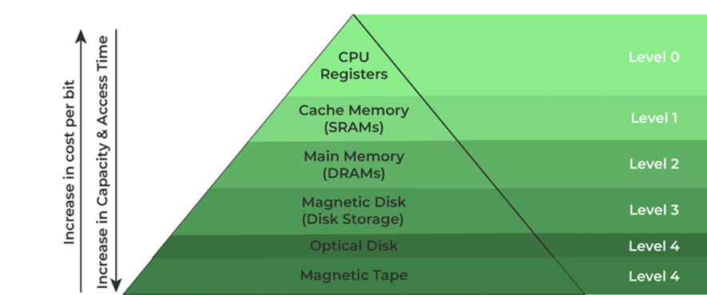
Memory hierarchy. Explanation of each level.

Slide 10

Explanation of each level.
1. Registers
Features: Small, high-speed memory units located within the CPU. Used to store the most frequently accessed data and instructions.
Access Speed: Fastest memory type, with access times in the range of 1 nanosecond (ns) or less.
Capacity: Typically 16 to 64 bits.
2. Cache Memory
Features: Small, fast memory located close to the CPU. Stores frequently accessed data from the main memory to reduce access time.
Types:
L1 Cache: Integrated into the CPU, very small (8KB to 64KB), and extremely fast.
L2 Cache: Larger than L1 (256KB to 8MB), slightly slower but still very fast.
L3 Cache: Shared among CPU cores, larger (up to 32MB), and slower than L2.
Access Speed: Typically 1 to 10 nanoseconds (ns)

Slide 11
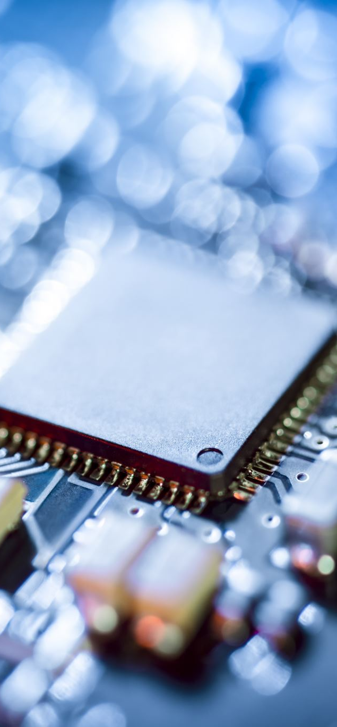
Explanation of each level.
3. Main Memory (RAM)
Features: Primary memory used to store data and instructions currently in use by the CPU. Larger capacity but slower than cache memory.
Types:
Static RAM (SRAM): Faster, used for cache memory. Access time around 10 nanoseconds (ns).
Dynamic RAM (DRAM): Slower, used for main memory. Access time around 50 to 70 nanoseconds (ns).
Capacity: Ranges from a few gigabytes (GB) to several terabytes (TB).
4. Secondary Storage
Features: Non-volatile memory with large storage capacity, used for long-term data storage.
Types:
Hard Disk Drives (HDDs): Magnetic storage, slower access times.
Solid-State Drives (SSDs): Flash memory, faster access times.
Access Speed:
HDDs: Typically 5 to 10 milliseconds (ms).
SSDs: Typically 0.1 to 1 millisecond (ms).
Capacity: Ranges from hundreds of gigabytes (GB) to several terabytes (TB).

Slide 12

Explanation of each level.
5. External Memory
Features: Includes peripheral storage devices like magnetic disks, optical disks, and magnetic tapes. Used for backup and archival purposes.
Access Speed: Generally slower than internal memory types.
Magnetic Disks: Similar to HDDs, around 5 to 10 milliseconds (ms).
Optical Disks: Access times around 100 milliseconds (ms).
Magnetic Tapes: Access times can be several seconds to minutes, depending on the data location.

Slide 13
Glossary.
Memoria Dinámica - Dynamic Memory
Memoria Estática - Static Memory
Memoria de Acceso Aleatorio Dinámico (DRAM) - Dynamic Random-Access Memory (DRAM)
Memoria de Acceso Aleatorio Estático (SRAM) - Static Random-Access Memory (SRAM)
Memoria de Solo Lectura Programable (PROM) - Programmable Read-Only Memory (PROM)
Memoria de Solo Lectura Programable y Borrable (EPROM) - Erasable Programmable Read-Only Memory (EPROM)
Memoria de Solo Lectura Programable y Borrable Eléctricamente (EEPROM) - Electrically Erasable Programmable Read-Only Memory (EEPROM)
Memoria de Acceso Aleatorio Síncrono (SDRAM) - Synchronous Dynamic Random-Access Memory (SDRAM)
Memoria - Memory
Registro - Register
Caché - Cache
RAM (Memoria de Acceso Aleatorio) - RAM (Random-Access Memory)
ROM (Memoria de Solo Lectura) - ROM (Read-Only Memory)
Memoria Flash - Flash Memory
Disco Duro - Hard Drive
SSD (Unidad de Estado Sólido) - SSD (Solid-State Drive)
Memoria Virtual - Virtual Memory
Memoria Principal - Main Memory
Memoria Volátil - Volatile Memory
Memoria No Volátil - Non-Volatile Memory
Memoria No Volátil - Non-Volatile Memory

Slide 14

Conclusion
This work helped me to learn different parts of memory system, such as main memory, cache memory etc. As well I improved my knowledge of English because of searching information on English sources.

Slide 15
Bibliography.
Computer memory | Types, Capacity & Speed | Britannica
A History of Hard Drives (backblaze.com)
The best RAM 2024: top memory for your PC | TechRadar
Búsqueda Microsoft Copilot: complemento de IA para el día a día
Wikipedia, the free encyclopedia

